Slide 1
Talent Development
At HCL

Slide 2
Jenkins

Slide 3
Introduction
Jenkins is a powerful application that allows continuous integration and continuous delivery of projects, regardless of the platform.
It is a free source that can handle any kind of build or continuous integration.
Jenkins can be integrated with a number of testing and deployment technologies
Jenkins will be installed on a server where the central build will take place.
Continuous Integration is a development practice that requires developers to integrate code into a shared repository at regular intervals. This concept was meant to remove the problem of finding later occurrence of issues in the build lifecycle. Continuous integration requires the developers to have frequent builds. The common practice is that whenever a code commit occurs, a build should be triggered.

Slide 4
Jenkins Cycle
Developers check in their source code
Jenkins will pick up the changed source code and trigger a build and run the test if required
The build output will be available in the Jenkins dashboard. Automatic notification can also be sent to the developer

Slide 5

Jenkins Download
Navigate to url - https://jenkins.io/download/
Download the Jenkins.war file.
Open a command prompt and navigate to the path where the .war file is located.
Run command – java –jar Jenkins.war
After the command is run, various task will run and once the process is complete, the following line will appear.

Slide 6
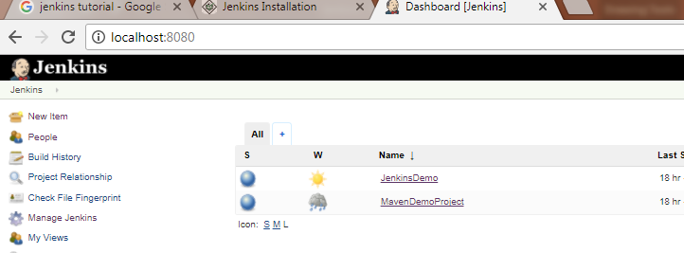
Accessing Jenkins
Open a browser and navigate to URL http://localhost:8080
This will bring up the Jenkins dashboard.

Slide 7
Jenkins – Plugin Setup
From Jenkins home page, select Manage Jenkins -> Manage Plugin.
Go to available tab.
Download all plugins for Maven, TestNG, Git Hub etc.

Slide 8
Jenkins – Global Setup
From Jenkins home page, select Manage Jenkins -> Global Tool Configuration
Setup the JDK setup by adding the JDK path in your system.
For Maven, set the path to the root folder where Maven is installed.
For Git, set the path to git.exe along with the path.

Slide 9
Jenkins – Project Creation
From Jenkins home page, select “New Item”.
Enter the project name. (Let’s create a Maven project for demo)
Select Project Type and click “Ok”.
Now from the source code management section, select
None: for creating a project in the local machine
Git – for creating a project fro Git Hub repository.
In Build, give the path of the pom.xml file depending on where is the project stored.
Local – From Eclipse, right click on the pom.xml -> copy the path and give it there.
Git – Go to the project folder -> Select “Clone or Download” option and copy the path.
In “Build”, mention clean test.

Slide 10
Github - Web
GitHub is a code hosting platform for version control and collaboration. It lets you and others work together on projects from anywhere.
Launch the url - https://github.com/
Create an account and sign in using the credentials.
Select + symbol and New Repository.
Put a name in Repository Name box.
Click on “Create Repository” folder.

Slide 11
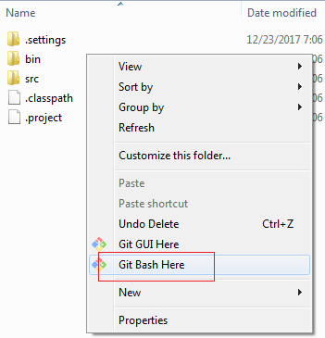
Github - Application
Google “Download Github”.
From url - https://desktop.github.com/, download the installer.
Install it.
Once installed, go the local directory where your source is stored.
Right click and select “Git Bash here”.
It will open a git console.

Slide 12
Github – Code Checkin
On the git console, run the following commands.
git init
git add .
git commit –m “Your comment”
git remote add origin https://github.com/sangramkswain/TestGit.git (you can get this directly from the github)
git push –u original master
It will upload the code in GitHub.

